Slide 1
OS Operations

Slide 2
Operating System Operations
An operating system is a construction that allows the user application programs to interact with the system hardware.
Operating system by itself does not provide any function but it provides an atmosphere in which different applications and programs can do useful work.
The major operations of the operating system are Dual mode and Timer.

Slide 3
Dual Mode Operations
In order to ensure the proper execution of the operating system, we must be able to distinguish between the execution of operating-system code and user defined code.
The approach taken by most computer systems is to provide hardware support that allows us to differentiate among various modes of execution.
At the very least, we need two separate modes of operation: user mode and kernel mode (also called supervisor mode, system mode, or privileged mode).
A bit, called the mode bit, is added to the hardware of the computer to indicate the current mode: kernel (0) or user (1).
With the mode bit, we are able to distinguish between a task that is executed on behalf of the operating system and one that is executed on behalf of the user.

Slide 4
When the computer system is executing on behalf of a user application, the system is in user mode.
However, when a user application requests a service from the operating system (via a system call), it must transition from user to kernel mode to fulfill the request.
As we shall see, this architectural enhancement is useful for many other aspects of system operation as well.
At system boot time, the hardware starts in kernel mode.
The operating system is then loaded and starts user applications in user mode.
Whenever a trap or interrupt occurs, the hardware switches from user mode to kernel mode (that is, changes the state of the mode bit to 0).
Thus, whenever the operating system gains control of the computer, it is in kernel mode.
The system always switches to user mode (by setting the mode bit to 1) before passing control to a user program.

Slide 5
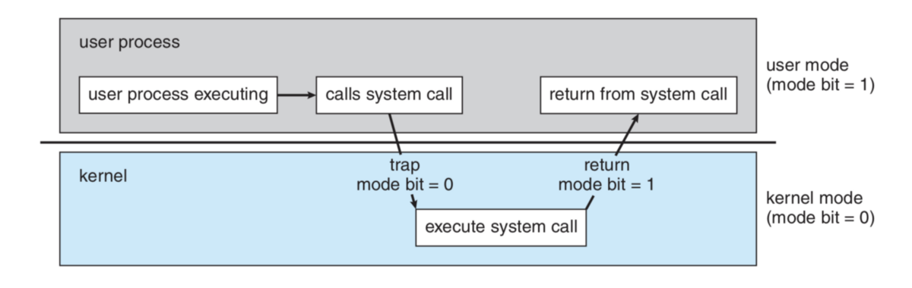
Fig. Transition from user to kernel mode

Slide 6
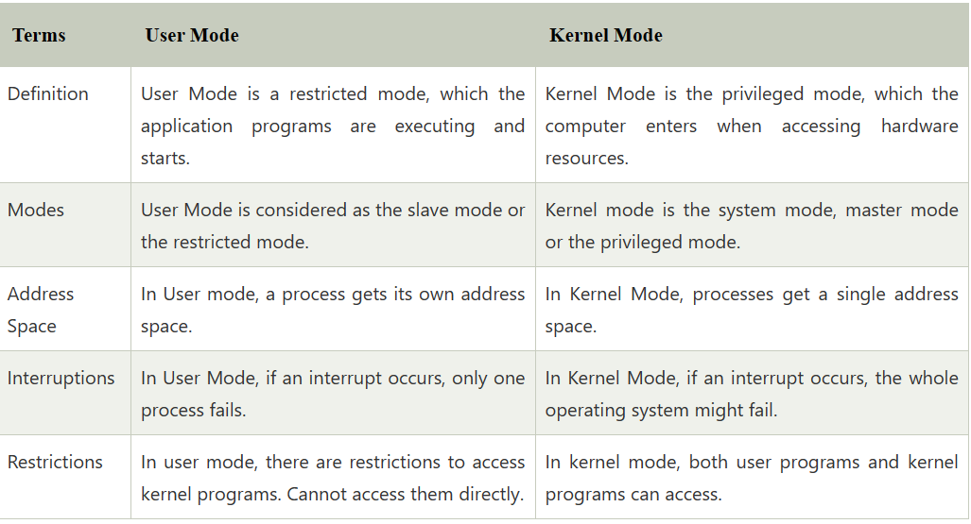

Slide 7
Timer
We must ensure that the operating system maintains control over the CPU.
We must prevent a user program from getting stuck in an infinite loop or not calling system services and never returning control to the operating system.
To accomplish this goal, we can use a timer.
A timer can be set to interrupt the computer after a specified period.
The period may be fixed (for example, 1/60 second) or variable (for example, from 1 millisecond to 1 second).
A variable timer is generally implemented by a fixed-rate clock and a counter.
The operating system sets the counter.
Every time the clock ticks, the counter is decremented.
When the counter reaches 0, an interrupt occurs.

Slide 8
For instance, a 10-bit counter with a 1-millisecond clock allows interrupts at intervals from 1 millisecond to 1,024 milliseconds, in steps of 1 millisecond.
Before turning over control to the user, the operating system ensures that the timer is set to interrupt.
If the timer interrupts, control transfers automatically to the operating system, which may treat the interrupt as a fatal error or may give the program more time.
Clearly, instructions that modify the content of the timer are privileged. Thus, we can use the timer to prevent a user program from running too long.

Slide 9
A simple technique is to initialize a counter with the amount of time that a program is allowed to run.
A program with a 7-minute time limit, for example, would have its counter initialized to 420.
Every second, the timer interrupts and the counter is decremented by 1.
As long as the counter is positive, control is returned to the user program.
When the counter becomes negative, the operating system terminates the program for exceeding the assigned time limit.

Slide 10
Evolutions of Operating System
1.Serial Processing:
The Serial Processing Operating Systems are those which Performs all the instructions into a Sequence Manner or the Instructions those are given by the user will be executed by using the FIFO Manner means First in First Out.
All the Instructions those are Entered First in the System will be Executed First and the Instructions those are Entered Later Will be Executed Later.
For Running the Instructions the Program Counter is used which is used for Executing all the Instructions.
In this the Program Counter will determines which instruction is going to Execute and the which instruction will be Execute after this. Mainly the Punch Cards are used for this.
In this all the Jobs are firstly Prepared and Stored on the Card and after that card will be entered in the System and after that all the Instructions will be executed one by One.
But the Main Problem is that a user doesn’t interact with the System while he is working on the System, means the user can’t be able to enter the data for Execution.

Slide 11
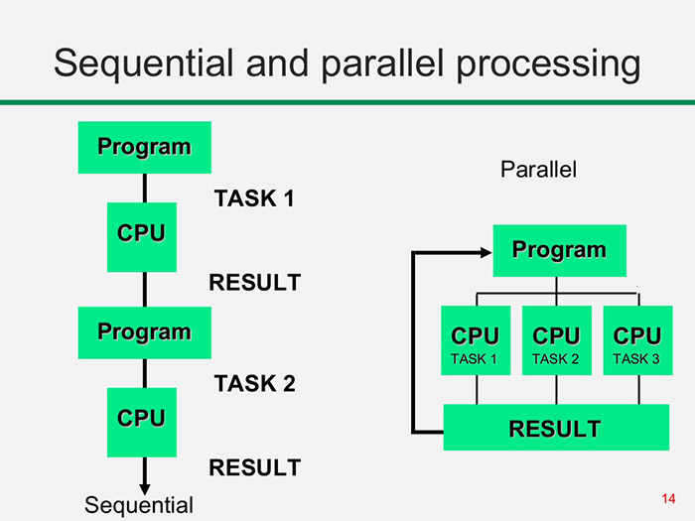

Slide 12
2.Simple Batch:
The batch strategy is implemented to provide a batch file processing.
It follows that files of the similar batch are processed to speed up the task.
Batch is nothing but set of jobs with similar needs.
Steps in Batch Operating System
The steps to be followed by batch operating system are as follows −
Step 1 − Using punch cards the user prepares his job.
Step 2 − After that the user submits the job to the programmer.
Step 3 − The programmer collects the jobs from different users and sorts the jobs into batches with similar needs.
Step 4 − Finally, the programmer submits the batches to the processor one by one.
Step 5 − All the jobs of a single batch are executed together.

Slide 13
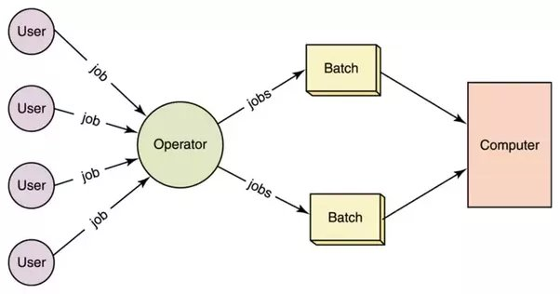
Simple Batch System

Slide 14
Advantages
The time taken by the system to execute all the programs will be reduced.
It can be shared between multiple users.
Disadvantages
The disadvantages of batch operating system are as follows −
Manual interrupts are required between two batches.
Priority of jobs is not set, they are executed sequentially.
It may lead to starvation.
The CPU utilization is low and it has to remain ideal for a long time because the time taken in loading and unloading of batches is very high as compared to execution time.

Slide 15
Multi-programmed operating system
Multiprogramming OS is an ability of an operating system that executes more than one program using a single processor machine.
More than one task or program or jobs are present inside the main memory at one point of time.
Buffering and spooling can overlap I/O and CPU tasks to improve the system performance but it has some limitations that a single user cannot always keep CPU or I/O busy all the time.
To increase resource utilization, multiprogramming approaches.
The OS could pick and start the execution of one of the jobs in memory, whenever the jobs does not need CPU that means the job is working with I/O at that time the CPU is idle at that time the OS switches to another job in memory and CPU executes a portion of it till the job issues a request for I/O and so on.

Slide 16
Let’s P1 and P2 are two programs present in the main memory. The OS picks one program and starts executing it.
During execution if the P1 program requires I/O operation, then the OS will simply switch over to P2 program.
If the p2 program requires I/O then again it switches to P3 and so on.
If there is no other program remaining after P3 then the CPU will pass its control back to the previous program.

Slide 17
Advantages
CPU utilization is high because the CPU is never goes to idle state.
Memory utilization is efficient.
CPU throughput is high and also supports multiple interactive user terminals.
Disadvantages
CPU scheduling is compulsory because lots of jobs are ready to run on CPU simultaneously.
User is not able to interact with jobs when it is executing.
Programmers also cannot modify a program that is being executed.

Slide 18
If several jobs are ready in main memory and if there is not enough space for all of them, then the system has to choose them by making a decision, this process is called job scheduling.
When the operating system selects a job from the group of jobs and loads that job into memory for execution, therefore it needs memory management, if several such jobs are ready then it needs CPU scheduling.

Slide 19
Parallel Operating System
If the collection of multiple processors from same motherboard then it is parallel system.
Parallel Systems are designed to speed up the execution of programs by dividing the programs into multiple fragments and processing these fragments at the same time.
Parallel computing is also called parallel processing.
There are multiple processors in parallel computing.
Each of them performs the computations assigned to them.
In other words, in parallel computing, multiple calculations are performed simultaneously.
The systems that support parallel computing can have a shared memory. So it is tightly coupled system.
In shared memory systems, all the processors share the memory.

Slide 20
There are multiple advantages to parallel computing.
As there are multiple processors working simultaneously, it increases the CPU utilization and improves the performance.
Moreover, failure in one processor does not affect the functionality of other processors.
Therefore, parallel computing provides reliability. On the other hand, increasing processors is costly.
Furthermore, if one processor requires instructions of another, the processor might cause latency.

Slide 21
Distributed System
If the collection of multiple processors is spread across the different geographical locations connected by network then known as distributed system.
Distributed computing divides a single task between multiple computers.
It is also called loosely coupled systems because in which each processor has its own local memory and processing units.
Each computer can communicate with others via the network.
All computers work together to achieve a common goal.
Thus, they all work as a single entity.
A computer in the distributed system is a node while a collection of nodes is a cluster.

Slide 22
Individual systems that communicate via a single channel are regarded as a single entity.
They're also known as loosely coupled systems.
This operating system consists of numerous computers, nodes, and sites joined together via LAN/WAN lines.
It enables the distribution of full systems on a couple of center processors, and it supports many real-time products and different users.
Distributed operating systems can share their computing resources and I/O files while providing users with virtual machine abstraction.

Slide 23
Why we should use distributed system?
Resource sharing:
if a number of different sites are connected together then the user at one site may be able to access the user at one site may be able to access the resources available at other site.
Computation speedup:
the particular computation can be partitioned into interdependent sub-computations which can run concurrently.

Slide 24
Reliability:
In distributed system, if one site fails then the remaining site can continue operating and hence the reliability is improved.
Communication:
When various sites are connected together, users can exchange information with the help of communication network.

Slide 25
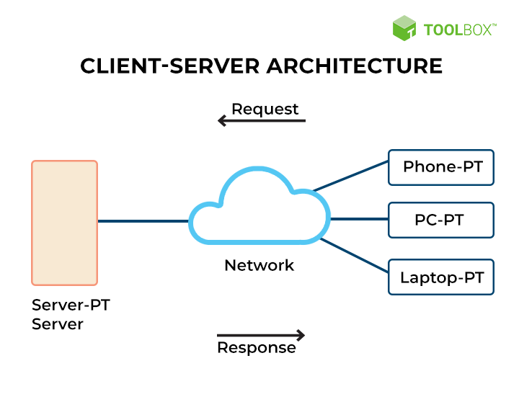

Distributed System

Slide 26
Real Time System
Real-time operating systems (RTOS) are used in environments where a large number of events, mostly external to the computer system, must be accepted and processed in a short time or within certain deadlines.
such applications are industrial control, telephone switching equipment, flight control, and real-time simulations.
With an RTOS, the processing time is measured in tenths of seconds. This system is time-bound and has a fixed deadline.

Slide 27
The processing in this type of system must occur within the specified constraints. Otherwise, This will lead to system failure.
Examples of the real-time operating systems: Airline traffic control systems, Command Control Systems, Airlines reservation system, Heart Pacemaker, Network Multimedia Systems, Robot etc.

Slide 28
1. Hard Real-Time operating system:
These operating systems guarantee that critical tasks be completed within a range of time.
For example, a robot is hired to weld a car body.
If the robot welds too early or too late, the car cannot be sold, so it is a hard real-time system that requires complete car welding by robot hardly on the time.

Slide 29
2.Soft real-time operating system:
This operating system provides some relaxation in the time limit.
For example – Multimedia systems, digital audio systems etc.
Explicit, programmer-defined and controlled processes are encountered in real-time systems.
A separate process is changed with handling a single external event.
The process is activated upon occurrence of the related event signaled by an interrupt.

Slide 30
Multitasking operation is accomplished by scheduling processes for execution independently of each other.
Each process is assigned a certain level of priority that corresponds to the relative importance of the event that it services.
The processor is allocated to the highest priority processes.
This type of schedule, called, priority-based pre-emptive scheduling is used by real-time systems.

Slide 31
Special Purpose System
There are various classes of computer systems based on their computational speed, usage, and hardware.
The following are some special-purpose systems according to specific applications.
They use:
Real-time embedded systems Multimedia systems
Multimedia systems
Handheld and portable systems

Slide 32
1. Real-time embedded systems Multimedia systems:
Embedded systems are small computers having a limited set of hardware like a small processor capable of processing a limited set of instructions (often called as an Application Specific Integrated Circuit (ASIC) a small memory (RAM or EPROM) and I/O devices.
These systems usually do specific tasks.
Examples are microwave ovens, robots in a manufacturing unit, latest automotive engines, etc.
A variety of embedded systems exists of which some are computers with standard operating systems, some have dedicated programs embedded in their limited memories and often some don’t even have any software, hardware (ASIC) to do processing.

Slide 33
Nearly all embedded systems use real-time operating system because they are used as control devices and have rigid time requirements.
Sensors are used to input data such as temperature, air pressure, etc., from the environment to embedded system where that data is analyzed and several other controls are adjusted by embedded system itself to control the situation of system.
A few examples are home appliance controllers, weapon controllers, boiler temperature controllers, fuel injection systems in automobile engines, etc.
A real-time system needs that processing to be done in fixed time constraints.

Slide 34
Multimedia systems:
Multimedia refers to data of multiple types that includes audio and video including conventional data like text files, word-processing documents, spreadsheets, etc.
It requires that audio and video data must be processed based upon certain time restrictions. This is called streaming.
It is usually 30 frames per second for a video file.
Applications such as video conferencing, movies and clips downloaded over the internet, mp3, DVD, VCD playing, and recording are examples of various multimedia applications.
A multimedia application is usually a combination of both audio and video.
Multimedia is not limited to desktop operating systems or computers but it is also becoming popular in handheld.

Slide 35
Handheld and portable systems:
Hand-held systems refers to small portable devices that can be carried along and are capable of performing normal operations.
They are usually battery-powered.
Examples include Personal Digital Assistants (PDAs), mobile phones, palm-top computers, pocket PCs etc.
As they are handheld devices, their weights and sizes have certain limitations as a result they are equipped with small memories, slow processors and small display screens, etc.
The physical memory capacity is very less (512 KB to 128 MB) hence the operating systems of these devices must manage the memory efficiently.
As the processors are slower due to battery problems, the operating system should not burden.

